Slide 1

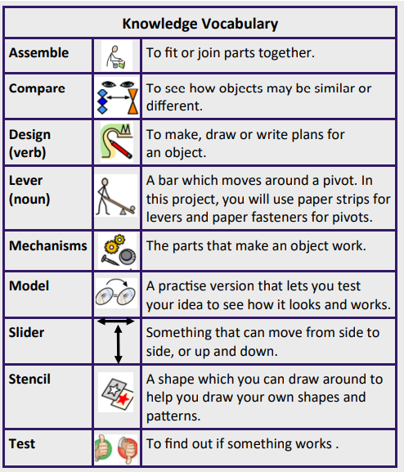
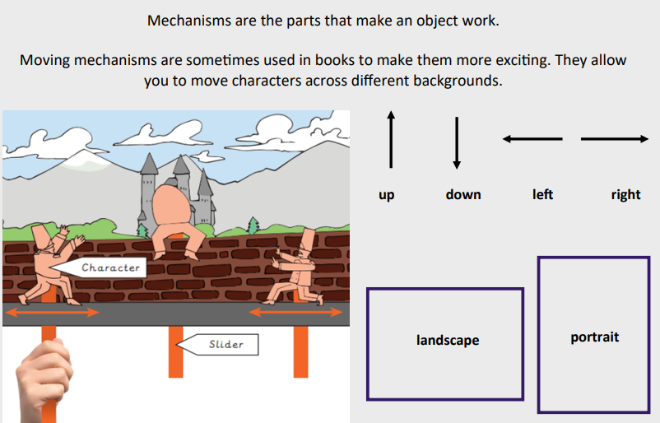
Year group: Year One Term: Spring Topic: Mechanisms- sliders and levers
Unit 2: Roman Britain
National Curriculum Objectives |  | Substantive Knowledge
explore and use mechanisms [for example, levers, sliders, wheels and axles], in their products design purposeful, functional, appealing products for themselves and other users based on design criteria evaluate their ideas and products against design criteria select from and use a range of tools and equipment to perform practical tasks
Prior Learning: EYFS- Junk Modelling
 |  |  |  |  |  | Disciplinary Knowledge
 |  |  |  |  |  | Understanding simple mechanisms that allow movement – sliding mechanisms
Future Learning
Year two- Mechniams
Teaching Ideas
Week One | Week Two |  | Week Three | Week Four | Week Five |  | Week Six
What is a mechanism? Technical knowledge | What are the different types of mechanism? Technical knowledge |  | What moving part will I make for my story? Design | Making a story book with a moving part. Make | Making a story book with a moving part. Make |  | How effective was my moving part? Evaluate
Product: Make a moving story Consumer: Foundation Stage children

Slide 2
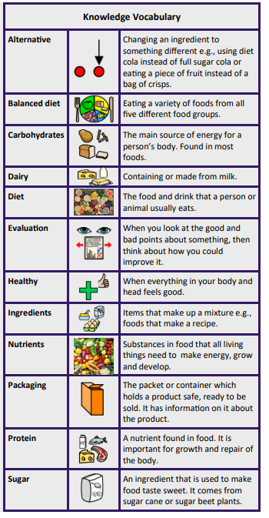
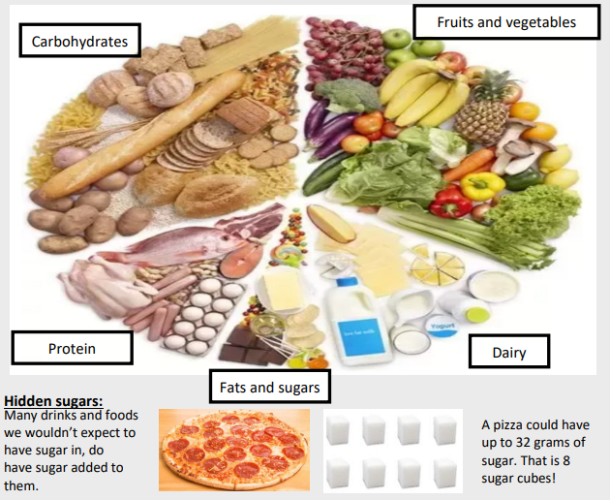
Year group: Year Two Term: Spring Topic: Cooking and nutrition
Unit 2: Roman Britain
National Curriculum Objectives |  | Substantive Knowledge
use the basic principles of a healthy and varied diet to prepare dishes design purposeful, functional, appealing products for themselves and other users based on design criteria evaluate their ideas and products against design criteria
Prior Learning: Year one- Preparing fruits and vegetables- the difference between fruits and vegetables- making fruit kebabs
 |  |  |  |  |  | Disciplinary Knowledge
Basic food handling, hygienic practices and personal hygiene, including how to control risks • Safe use of a variety of tools and equipment to peel, cut, grate, mix and mould food • The nutritional value of food stuffs in a balanced diet
Future Learning
Y
Teaching Ideas
Week One | Week Two |  | Week Three | Week Four | Week Five |  | Week Six
What is a balanced diet? Technical knowledge | Classifying foods into categories. Technical knowledge |  | Can I design a balanced meal for my teacher? Design | Make | Make |  | Evaluate
Product: A balanced meal Consumer: Class teacher

