Slide 1

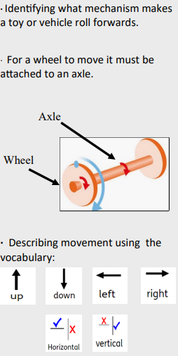
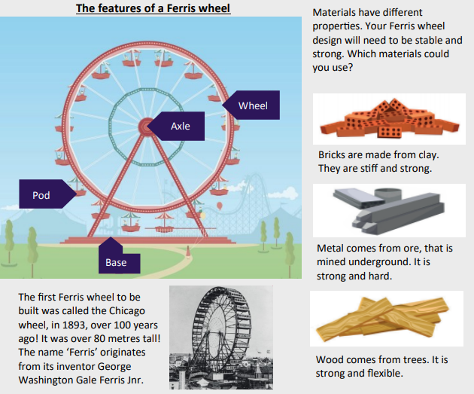
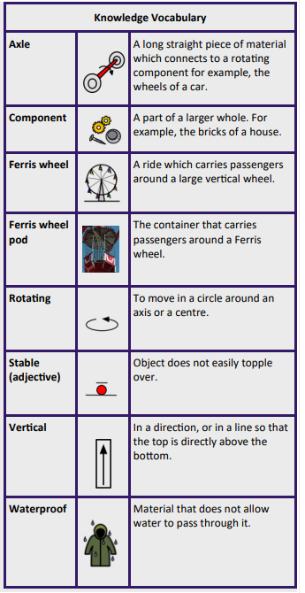
Year group: Year Two Term: Autumn Topic: Mechanisms- Wheels and Axles
Unit 2: Roman Britain
National Curriculum Objectives |  | Substantive Knowledge |  |  |  | Vocabulary
Design purposeful, functional, appealing products for themselves and other users based on design criteria. Generate, develop, model and communicate their ideas through talking, drawing, templates, mock-ups and, where appropriate, information and communication technology Select from and use a wide range of materials and components, including construction materials, textiles and ingredients, according to their characteristics Build structures, exploring how they can be made stronger, stiffer and more stable Explore and use mechanisms [for example, levers, sliders, wheels and axles], in their products.
 |  |  |  |  |  | Key Historians | High quality texts
Prior Learning |  |  |  |  |  | Disciplinary Knowledge
Year One- Moving books- mechanisms sliders and levers
Future Learning
Teaching Ideas
Week One | Week Two |  | Week Three | Week Four | Week Five |  | Week Six
Investigating how toys/vechicles work Technical knowledge | Wheels and axles Properrties of materials |  | Design ferris wheel | Make ferris wheel | Make ferris wheel |  | Evaluate ferris wheel
Product: Ferris Wheel Consumer: Small world figures

Slide 2
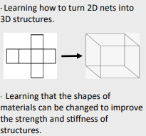
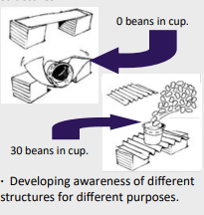
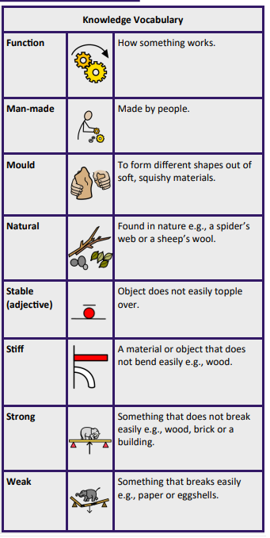
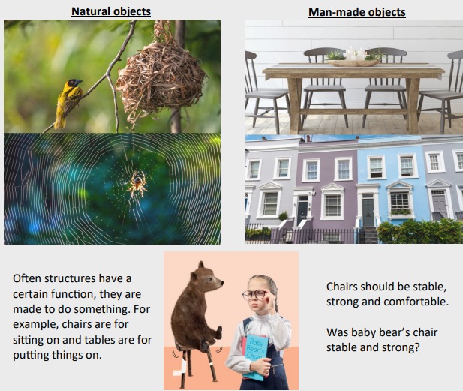
Year group: Year One Term: Autumn Topic: Free standing structures
Unit 2: Roman Britain
National Curriculum Objectives |  | Substantive Knowledge |  |  |  | Vocabulary
Design purposeful, functional, appealing products for themselves and other users based on design criteria. Generate, develop, model and communicate their ideas through talking, drawing, templates, mock-ups and, where appropriate, information and communication technology. Select from and use a wide range of materials and components, including construction materials, textiles and ingredients, according to their characteristics Build structures, exploring how they can be made stronger, stiffer and more stable
 |  |  |  |  |  | Key Historians | High quality texts
Prior Learning |  |  |  |  |  | Disciplinary Knowledge
EYFS- Junk modelling
Future Learning
Year Two: Mechanisms- Ferris Wheel
Teaching Ideas
Week One | Week Two |  | Week Three | Week Four | Week Five |  | Week Six
Sorting natural and manade objects | Investigate how shapes can be changed to improve strength of a structure |  | Design a chair for baby bear | Make a chair for baby bear | Make a chair for baby bear |  | Evaluate chair
Product: Chair for Baby Bear Consumer: Baby Bear

