Slide 1







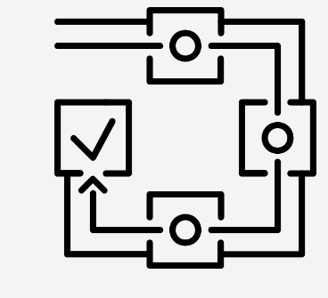











Signhills Infant Academy Computing Big Ideas
Technology
around us
Digital
Painting
Moving a
Robot
Grouping Data
Digital
Writing
Programming
Animations
Digital
Photography
Robot
Algorithms
Pictograms
Digital Music
Programming
Quizzes
Build an Overview
Information Technology
Computer Science
Digital Literacy
E-Safety
Computing Systems and Networks
Programming
Creating Media
Data and Information

Slide 2
Signhills Infant Academy Computing Long Term Plan
Year Groups | Autumn | Spring | Summer
Reception
Year 1
Year 2

