Slide 1
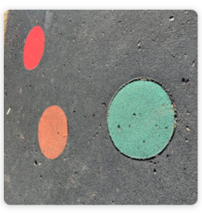
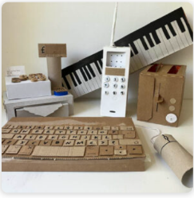
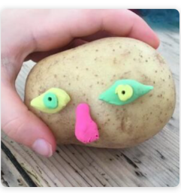
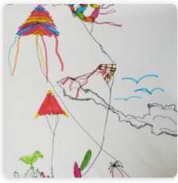
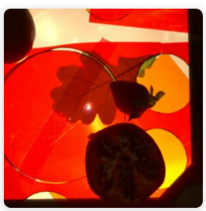
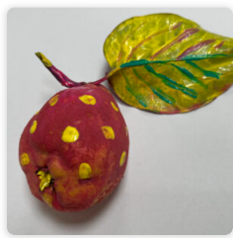
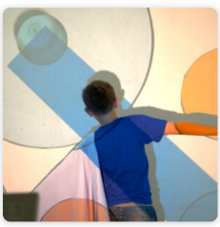








Signhills Infants Academy Art Big Ideas –EYFS
How can we explore colour?
How can we explore materials and marks?
How can we use our bodies to make art?
What can we see?
How can we build worlds?
How can we explore 3d materials?
How can we use our imaginations?
Select/collect examples
Art
Vocabulary
Fine motor skills
Observation
Share views and opinions
Similarities &
differences
What can we see?
Emotions
Technique
Generating ideas
Making
Evaluating
Visual
Language
Exploration
Cause and consequence
Different versions
Ask & answer questions
Similarities &
differences
Sources of evidence created by the greats
Drawing and sketchbooks
Print, colour and collage
Working in three dimensions
Collaboration and community
Paint, surface and texture

Slide 2
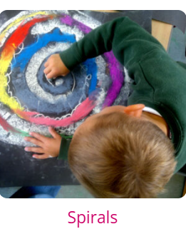
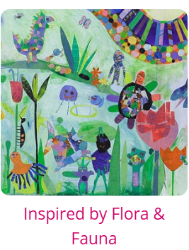
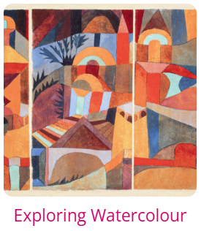
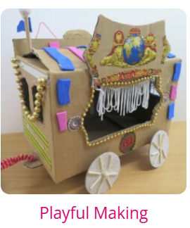
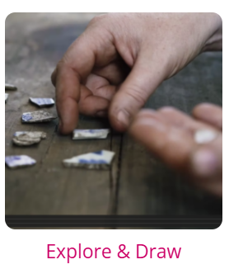
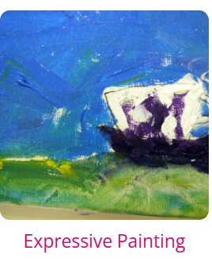
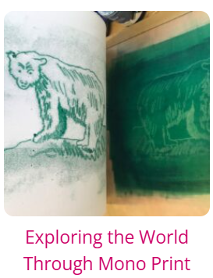
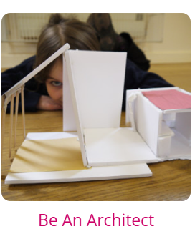
Signhills Infants Academy Art Big Ideas- KS1
Autumn 2
Year 1
Spring 2
Year 1
Summer 1
Year 1
Summer 2
Year 1
Autumn 2
Year 2
Spring 2
Year 2
Summer 1
Year 2
Summer 2
Year 2
Select/collect examples
Art
Vocabulary
Fine motor skills
Observation
Share views and opinions
Similarities &
differences
Emotions
Evaluating
Technique
Generating ideas
Exploration
Making
Different versions
Sources of evidence created by the greats
Ask & answer questions
Visual
Language
Similarities &
differences
Cause and consequence
Paint, surface and texture
Drawing and sketchbooks
Print, colour and collage
Working in three dimensions
Collaboration and community

