Slide 1

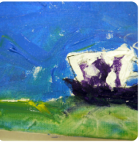



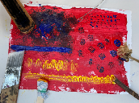
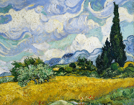
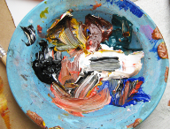
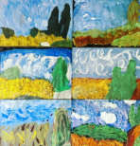
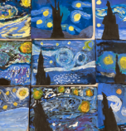
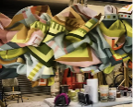
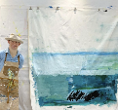
Year group: 2 Term: Spring 2 Topic: Expressive Painting (Access Art)
Unit 2: Roman Britain
Key Objectives |  | Substantive Knowledge | Substantive Knowledge |  | Vocabulary
That artists sometimes use loose, gestural brush marks to create expressive painting. Expressive painting can be representational or more abstract. Artists use impasto and sgraffito to give texture to the painting. Artists sometimes use colour intuitively and in an exploratory manner. That we can enjoy, and respond to, the way paint and colour exist on the page. |  | Know who I am and where I fit. Know how good it feels to feel special and safe. Know that they belong as part of a class. Know their rights and responsibilities as a member of that class. Know that rewards can help them to feel proud. Know about consequences for bad choices. Know that they own the learning charter. | In this pathway children are introduced to the idea that they can use paint in an intuitive and exploratory way. The pathway starts with an introduction to artists who use paint and colour to create exciting gestural and abstract work. Children explore primary colours and secondary colours through expressive mark making, connecting colour, mark making and texture (of paint) through abstract work. Pupils then explore the brush work of two old masters when we focus in on details of paintings to understand how they built the work. Pupils then go on to draw from a colourful still life, finally making expressive and gestural paintings with acrylic paint. Sketchbooks are used throughout to record, experiment and reflect. |  | Acrylic Paint, texture, primary, secondary, tints, shades, hues
Prior Learning |  |  |  |  | Key People
 |  |  |  |  | Marela Zacarías, Charlie French, Vincent Van Gogh, Cezanne
 |  |  |  |  | Disciplinary Knowledge; Painting, Sketchbooks
 |  |  |  |  | I have seen how artists, contemporary and old masters, sometimes use paint in an expressive, loose way to create paintings full of life and colour. I can start to share my response to the work of other artists. I can use my sketchbook to fill full of colour and brush marks, inspired by other artists. I can recognise primary colours and mix secondary colours. I can experiment with hues by changing the amount of primary colours I add. I can make a loose drawing from a still life. I can see colours and shapes in the still life. I can use my gestural mark making with paint, and incorporate the colours and shapes in the still life to make an expressive painting.
Prior Learning
Year 1 –Explored the properties of watercolour and discovered how we can work WITH the characteristics of the medium to make art. Basic colour awareness and mixing. |  |  |  |  | Disciplinary Knowledge; Painting, Sketchbooks
Future Learning
Year 3 –Continue to understand and explore that there are many different ways to paint – none of which are “better” than others. Continue to develop experience and understanding of paint as a medium, and of HOW we apply paint and the INTENTION behind our action affect outcome. Continue to build experience of colour mixing, hues and tints. Continue to develop understanding of how others respond to art, bringing their own unique perspective.
Teaching Ideas
Week One; Introduce | Week Two; Explore | Week Three; Explore |  | Week Four and Week Five; Explore and Create |  | Week Six; Share and Celebrate
Explore the Work of Marela Zacarías & Charlie French Resources- talking points. Sketch books for visual notes | Expressive Painting & Colour Mixing | Brush Work of Van Gogh & Cezanne Resources- talking points. Sketch books for visual notes Resource- Experimental Mark making Tools |  | Gestural Mark Making with Acrylic Paint Children begin by working on a still life of colour and form and progress to working on elements of landscape. |  | Collaborate; children have the chance to collectively display and to discuss the work created and the intention behind it.
Big Finish: Whole School Exhibition

