Slide 1

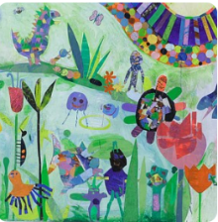





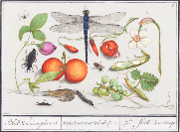
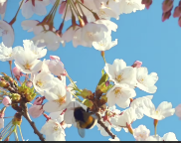
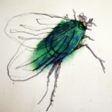
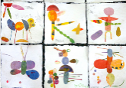
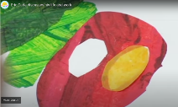
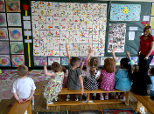
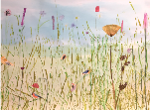
Year group: 1 Term: Spring 2 Topic: Inspired by Florals and Fauna (Access Art)
Unit 2: Roman Britain
Key Objectives |  | Substantive Knowledge | Substantive Knowledge |  | Vocabulary
That artists can be inspired by the flora and fauna around them. That we can use careful looking to help our drawing, and use drawing to help looking. That we can use a variety of materials to make images, and that the images we make can become imaginative. That we can create individual artwork, and that we can bring that artwork together to make a shared artwork. |  | Know who I am and where I fit. Know how good it feels to feel special and safe. Know that they belong as part of a class. Know their rights and responsibilities as a member of that class. Know that rewards can help them to feel proud. Know about consequences for bad choices. Know that they own the learning charter. | In this pathway children are introduced to the idea that many artists use flora and fauna to inspire their work. We look at artists who used drawing as a way to accurately capture the way plants and insects look, and artists who use their imagination to create their own versions of flora and fauna. Children spend time engaged in close looking as a way to build drawing skills. They also experiment with new materials. They practice cutting and collage skills and explore shape and colour to build images. Finally there is the opportunity for children to work collaboratively on a shared background for the artwork, and pupils can see how their individual efforts are valued as part of a larger class artwork. |  | Handwriting pen, Graphite, Oil pastel, Paper & Collage
Prior Learning |  |  |  |  | Key People
 |  |  |  |  | Eric Carle, Joseph Redoute, Jan Van Kessel,
Prior Learning
Reception – |  |  |  |  | Disciplinary Knowledge;
Reception – I understand how it feels to belong and that we are similar and different. I can start to recognise and manage my feelings. I enjoy working with others to make school a good place to be. I understand why it is good to be kind and use gentle hands. I am starting to understand children’s rights and this means we should all be allowed to learn and play. I am learning what being responsible means. |  |  |  |  | Drawing, collage, sketchbooks I can look closely at insects and plants and make drawings using pen to describe what I see. I can experiment using graphite and oil pastel and make my own insects. I can cut out shapes in different colours, and use these shapes to make an insect or bug. I can think about its body parts and what I would like them to look like
Future Learning
Year 2 –Continue to develop understanding of how we can use line, shape and colour to make imagery, developing composition skills. Understand the importance of observation and imagination in making art. Appreciation that when we make art we can work alone or collaboratively to make work.
Teaching Ideas
Week One; Introduce | Week Two; Show me what you see | Week Three; Deepen the Exploration |  | Week Four and Week Five; Deepen the Exploration |  | Week Six; Share and Celebrate
Explore the Work of Artists Who Are Inspired by Flora & Fauna (talking points) | Drawing from Film; Drawing source material; Insects | Using Graphite and Oil Pastel |  | Make your mini-beast collage (Mini beast art work resource) Inspire- Talking Points - Eric Carle resource |  | Collaborate; create a wild flower meadow backdrop to display our insects. Resources – drawing source material wild flower and Wild Flower
Big Finish: Whole School Exhibition

